Slide 1
Selenium Locators
Id
Xpath
Name
className
CSS Selector
linkedText
PartialLinkedTexxt
tagName

Slide 2
As we can see, Selenium supports the following locators:
--------------------------------------------------------------------------------
ClassName – A ClassName operator uses a class attribute to identify an object.
cssSelector – CSS is used to create style rules for webpages and can be used to identify any web element.
Id – Similar to class, we can also identify elements by using the ‘id’ attribute.
linkText – Text used in hyperlinks can also locate element
name – Name attribute can also identify an element
partialLinkText – Part of the text in the link can also identify an element
tagName – We can also use a tag to locate elements
xpath – Xpath is the language used to query the XML document. The same can uniquely identify the web element on any page.

Slide 3
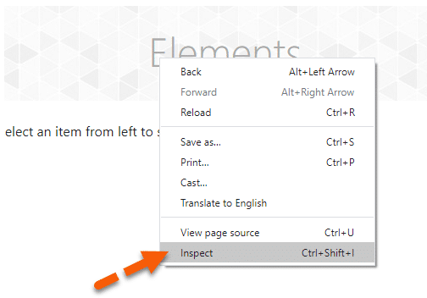
As we all know, the first thing to start with is to find the HTML element in DOM (Document Object Model), for which we need to grab the locator. We can follow the following steps to identify the web element in DOM on a web browser: 1. DOM can be accessed in Google Chrome either by pressing F12 or by right click on the web page and then by selecting Inspect (as shown in the screenshot below).

Slide 4
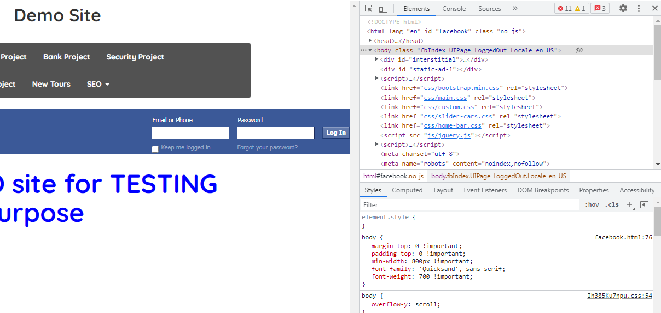
2. Once we click on the "Inspect option", it will open the Developer Tools console, as shown below. By default, it will open the "Elements" tab, which represents the complete DOM structure of the web page. Now, if we hover the mouse pointer over the HTML tags in the DOM, it will highlight the corresponding elements it represents on the webpage.

Slide 5
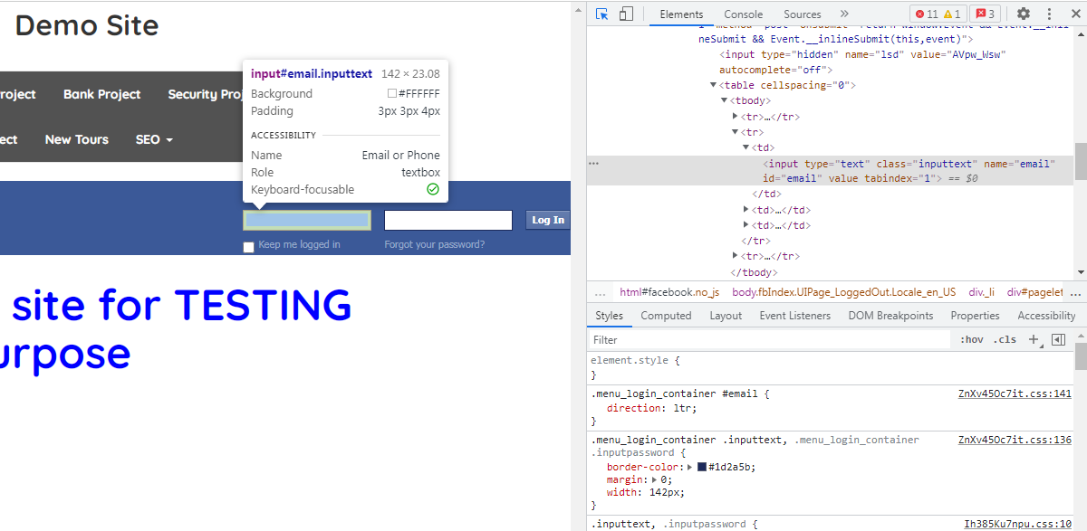
3. Now, the main point is, how do we find the web element in the DOM. Click on the "Mouse Icon" arrow and then select the web element on the web page. It will automatically highlight the corresponding HTML element in the DOM. Suppose we want to find the HTML elements corresponding to the banner. When we select the mouse point and click on the banner image, it will automatically highlight the corresponding HTML element, as shown in the below screenshot:

Slide 6
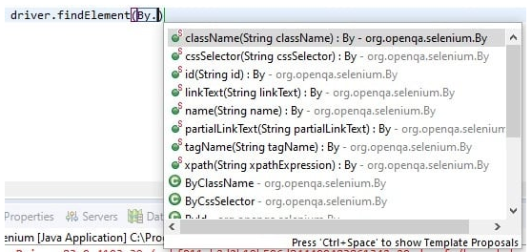
To access all these locators, Selenium provides the “By” class, which helps in locating elements within the DOM. It offers several different methods (some of which are in the image below) like className, cssSelector, id, linkText, name, partialLinkText, taName, and xpath, etc., which can identify the web elements based on their corresponding locator strategies. You can quickly identify all the supported locators by Selenium by browsing all the visible methods on the "By" class, as shown below:

Slide 7
How to locate a web element by using the "id" attribute? ------------------------------------------------------------------
"ID" as a locator is one of the most common ways of identifying elements on a web page. According to W3C, an ID for a web element always needs to be unique. The ID is one of the fastest and unique ways of locating web elements and is considered as one of the most reliable methods for determining an element. But with the advancement in technologies and more of the dynamic web pages, "IDs" are generated dynamically and generally not the reliable way to locate a web element, as they change for different users.

Slide 8
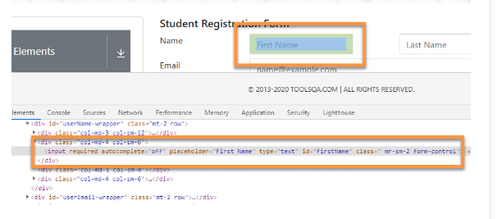
<input required="" autocomplete="off" placeholder="First Name" type="text" id="firstName" class=" mr-sm-2 form-control">

Slide 9

As we can see, the HTML tag contains the attribute “id” inside the input tag. The id here used is the “firstName*” which we can use to locate this element in the web page. Now, to find the “First Name” text box on the web page, we can use the following syntax:
As we can see that we have used the "By.id()" method, and we have passed the "firstName", which is the "id" of the text box we are trying to locate. So, this way, we can locate any web element which has a specified "id" attribute associated with it.

Slide 10
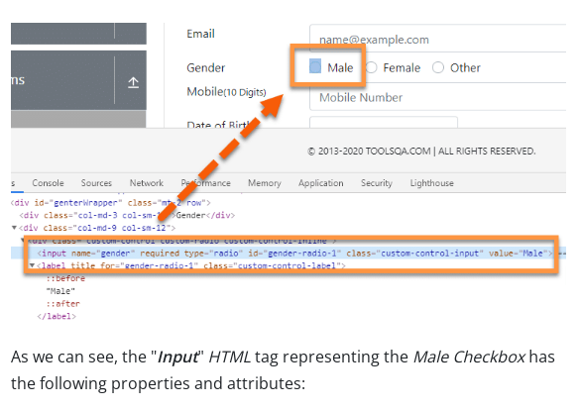
How to locate a web element by using the "name" attribute?
<input name="gender" required="" type="radio" id="gender-radio-1" class="custom-control-input" value="Male">

Slide 11

We can see the attribute ‘name ‘ with value as ‘gender’. We can use the following syntax to locate the web element using the "By" class.
As we can see, the "By" class provides the "name" method, which accepts the value of the "name" attribute of the web element. So, using this, we can locate a web element that has a unique name attribute.

Slide 12
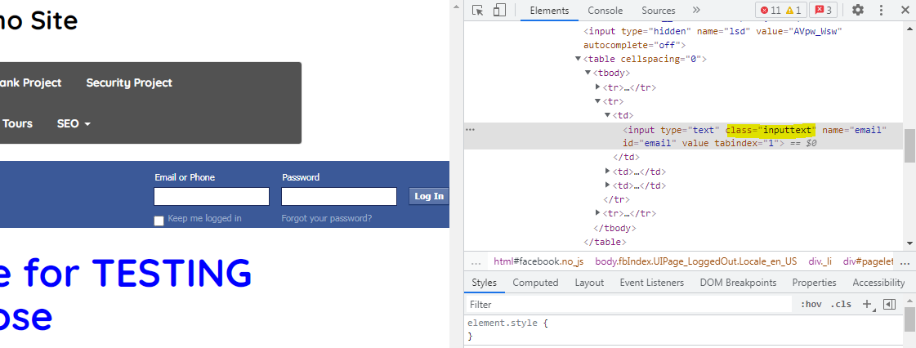
How to locate a web element by using the "ClassName" attribute?
ClassName allows Selenium Selenium to find web elements based on the class values of the DOM. For example, if we want to identify or perform any operation on the form element, we can use the class to identify it.

Slide 13
class=" inputtext "
We can use the class attribute value from the above DOM to identify the form. To identify the same on the webpage, we can use the following syntax.
By.className(" inputtext ");
To identify it successfully, we need to make sure that the class name value that we are using for locating the web element, i.e., web form, is unique, and any other class doesn’t have the same value. If any other class contains the same value as this, then Selenium will select whichever element comes first while scrapping through the web page.

Slide 14
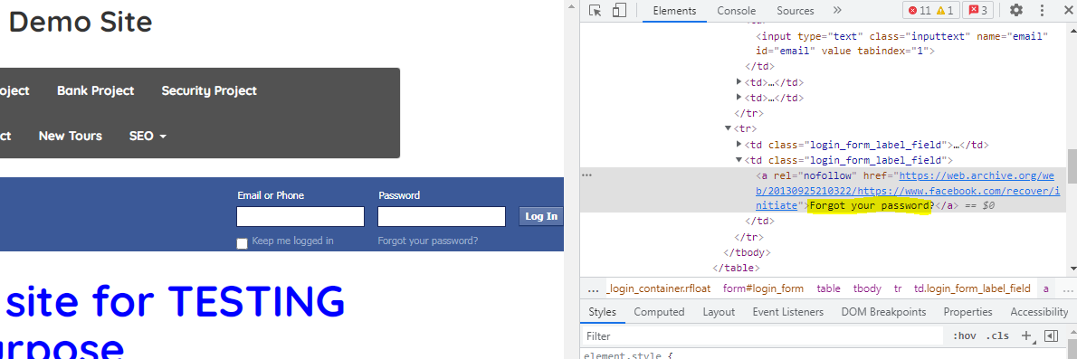
How to locate a web element by using the "LinkText" and "partialLinkText" attribute?
LinkText and partialLinkText both are quite similar in functionality and locate web elements by using the hyperlink texts. We can only use them for elements containing anchor(<a>) tags. Similar to other locator strategies, if multiple hyperlinks with the same texts are present on the page, then Selenium will always choose the first one.

Slide 15
For identifying elements using link text or partial link text, we need to use the hyperlink text, as shown below:
By.linkText("Forgot your password?");
Similarly, partial link text can also recognize the element by using part of the hyperlink text, as shown below:
By.linkText("Forgot");
It will identify any link that contains ‘Ho’ in the hyperlink text. Likewise, if several links are containing “Forgot”, then Selenium will select the first one.

Slide 16

What is XPath in Selenium?
XPath can be effectively used to identify and locate almost any element present on a web page.
It is quite helpful while working on a dynamic web page where the web element's unique attributes are not constant.
Moreover, it allows us to write XML document navigation flow for locating web elements.
Syntax of XPath
The XPath syntax generally starts with “//” double slash. That is to say, it will begin with the current node defined by the tag name.
The next part is tag_name; it denotes the HTML tag name of the node.
Subsequently, anything present inside the node encloses in the square brackets.
Additionally, the “@” sign selects the attribute.
Moreover, the “Attribute_name” is the name of the attribute of the node.
And, the “Value of attribute” denotes the attribute value from the node.

Slide 17
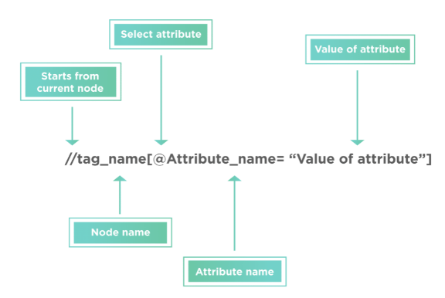

Slide 18
Types of X-path There are two types of XPath: 1) Absolute XPath 2) Relative XPath
Absolute XPath:
It is the direct way to find the element, but the disadvantage of the absolute XPath is that if there are any changes made in the path of the element then that XPath gets failed.
The key characteristic of XPath is that it begins with the single forward slash(/) ,which means you can select the element from the root node.
Relative Xpath:
Relative Xpath starts from the middle of HTML DOM structure. It starts with double forward slash (//). It can search elements anywhere on the webpage, means no need to write a long xpath and you can start from the middle of HTML DOM structure. Relative Xpath is always preferred as it is not a complete path from the root element.

Slide 19
1) Basic XPath: XPath expression select nodes or list of nodes on the basis of attributes like ID , Name, Classname, etc.
//input[@id='firstName']
2) Contains():
Contains() is a method used in XPath expression. It is used when the value of any attribute changes dynamically, for example, login information.
The contain feature has an ability to find the element with partial text as shown in below XPath example.
In this example, we tried to identify the element by just using partial text value of the attribute. In the below XPath expression partial value ‘sub’ is used in place of submit button. It can be observed that the element is found successfully.
Complete value of ‘Type’ is ‘submit’ but using only partial value ‘sub’.
//label[contains(text(),'Male')]
//label[contains(text(),'Sports')]
//*[contains(@type, 'sub')]
//*[contains(@id, 'userNumber')]

